Slide 1


Slide 2


Slide 3


Slide 4
Relation between equilibrium constant & standard free energy change

Slide 5

Relation between equilibrium constant & standard free energy change

Slide 6


Slide 7
9.04 x 10⁻¹⁶

Slide 8


Slide 10


Slide 11


Slide 12



Slide 13
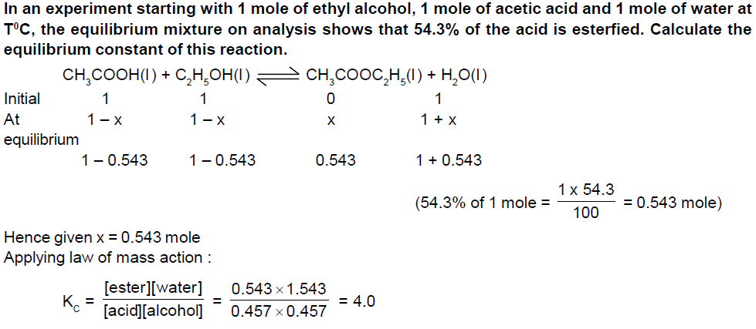

Slide 14


Slide 15


Slide 16


Slide 17


Slide 18
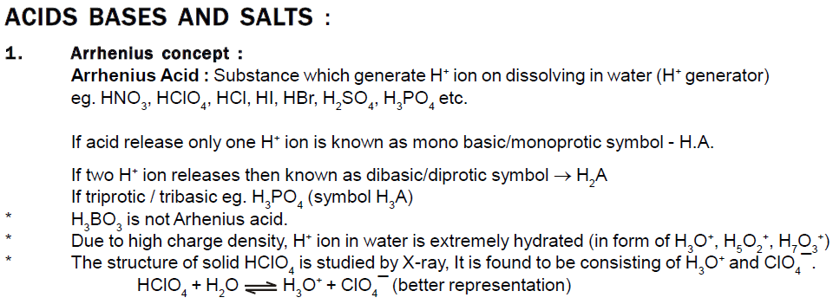

Slide 19


Slide 20
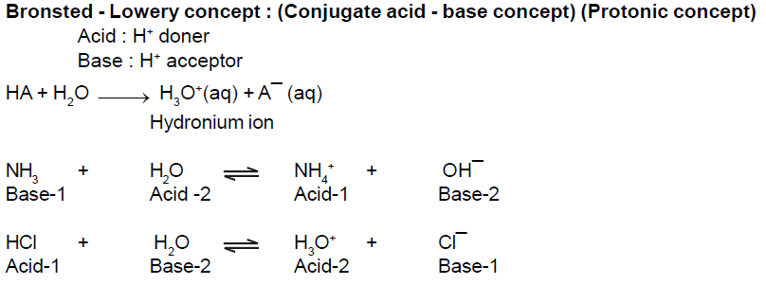

Slide 21
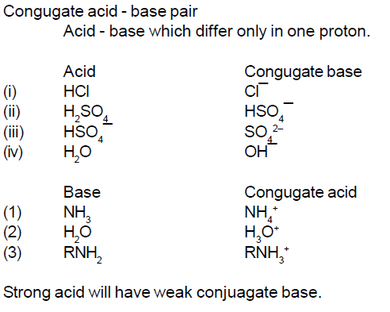

Slide 22


Slide 23


Slide 24


Slide 25
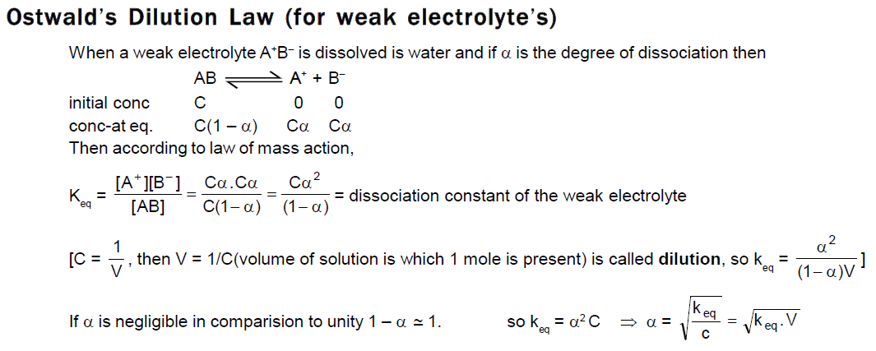

Slide 26
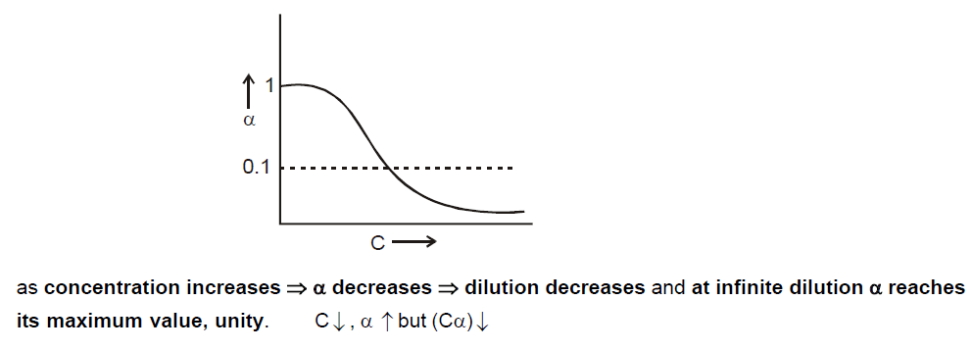

Slide 27


Slide 28


Slide 29


Slide 30
pK_{a,} K_{a ,} acidic strength

Slide 31
The pH of 12M HCl (hydrochloric acid) is calculated to be_______________

Slide 32


Slide 33


Slide 34

Ionic product of water is always a constant whatever has been dissolved in water since its an equilibrium constant so will be dependent only on temperature

Slide 36
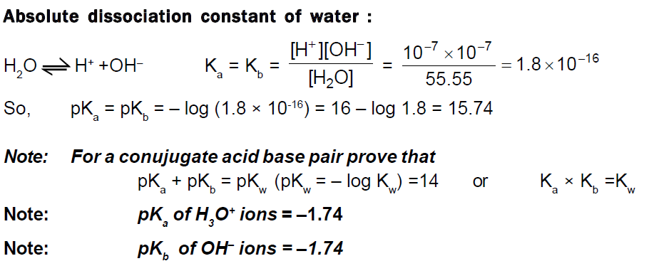

Slide 37
Which is stronger acid H₃O⁺ or acetic acid (K_{a} = 1.8 × 10⁻⁵)

Slide 38
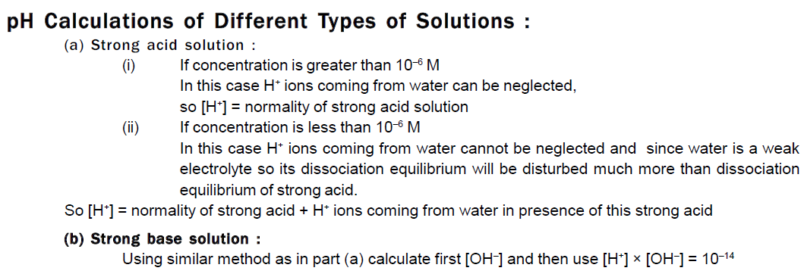

Slide 40


Slide 41


Slide 42
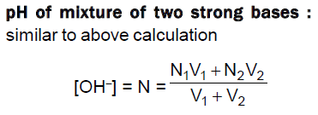

Slide 44
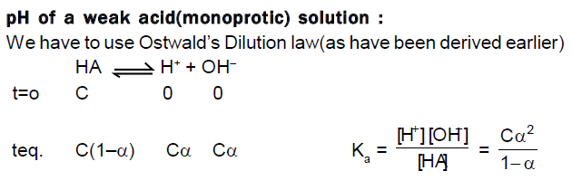

Slide 45


Slide 46


Slide 47
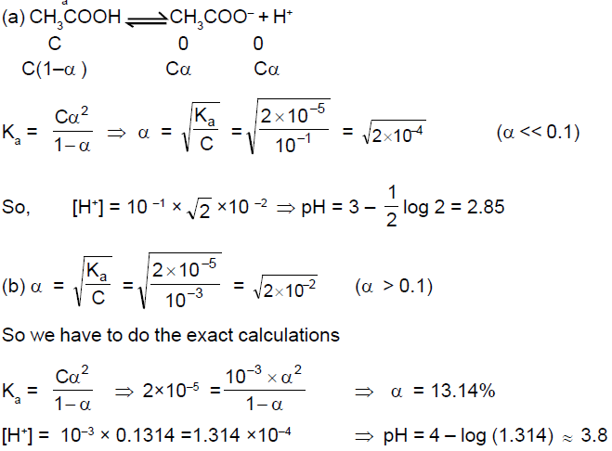

Slide 49


Slide 50
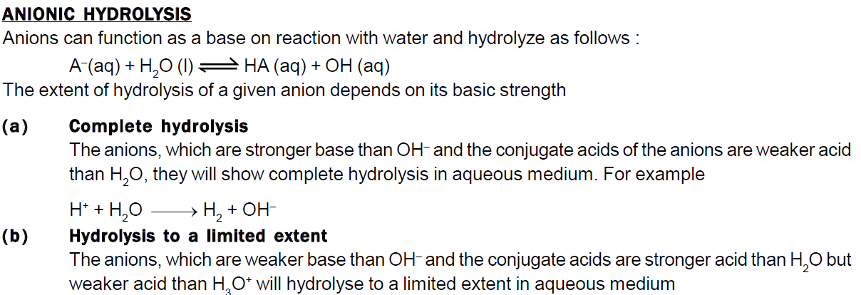

Slide 51


Slide 52


Slide 53
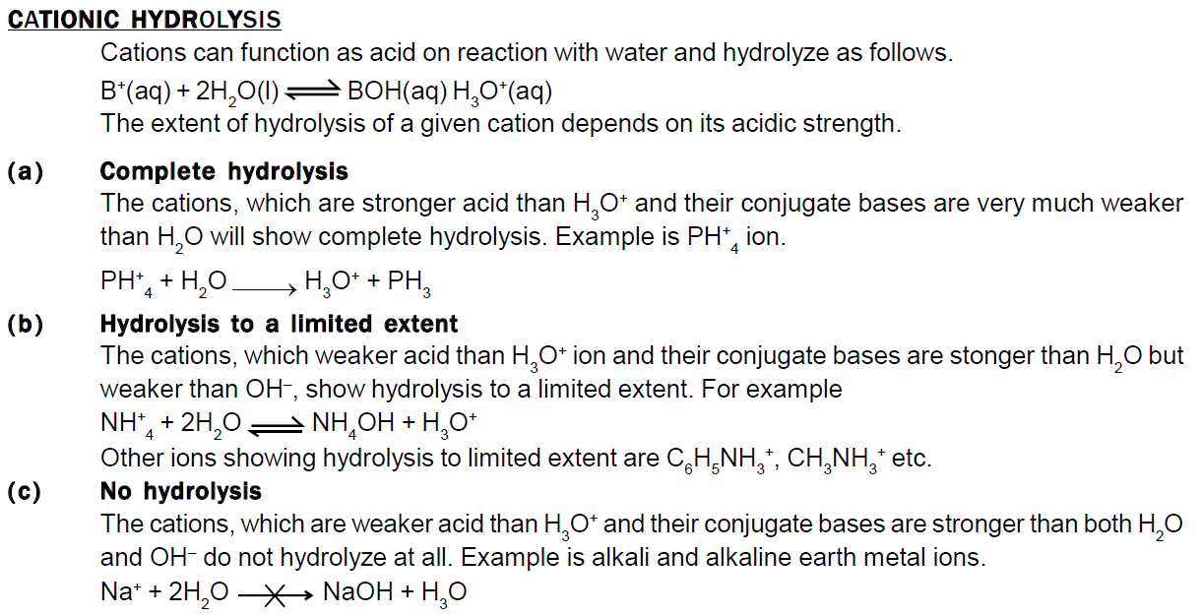

Slide 54


Slide 55
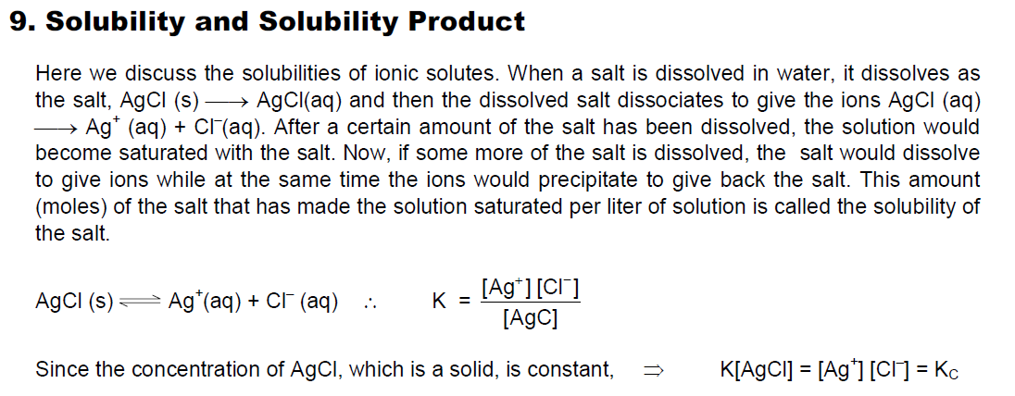


Slide 56
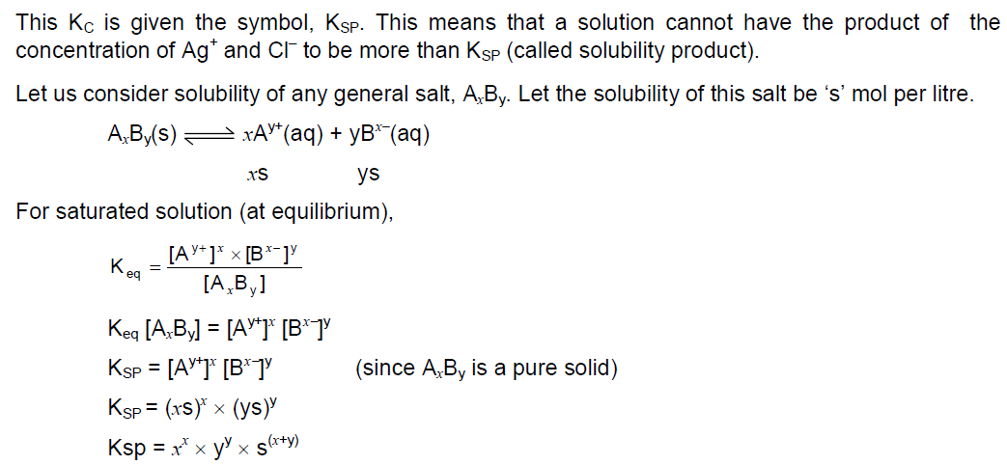


Slide 57
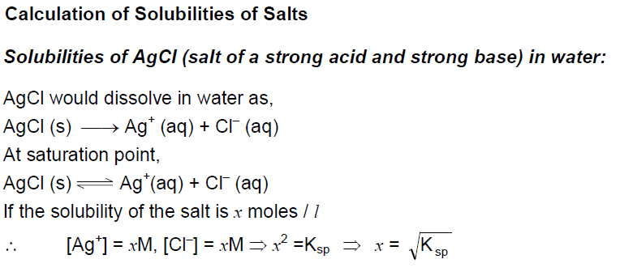


Slide 58
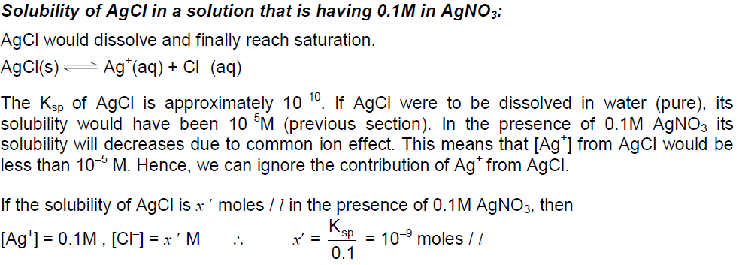
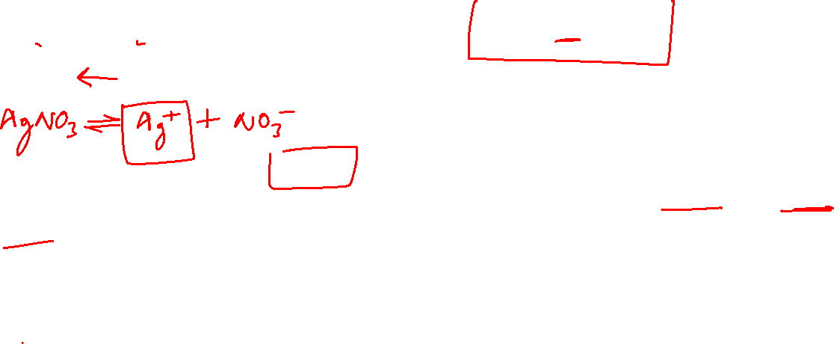

Slide 59
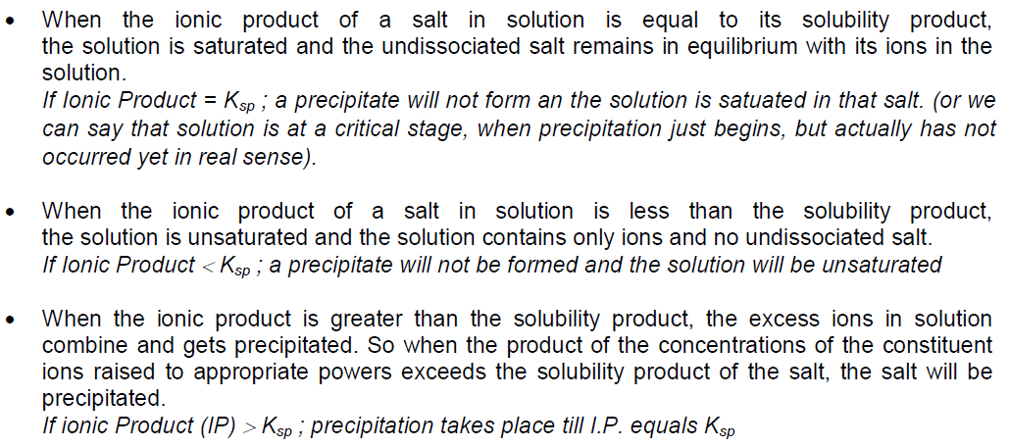
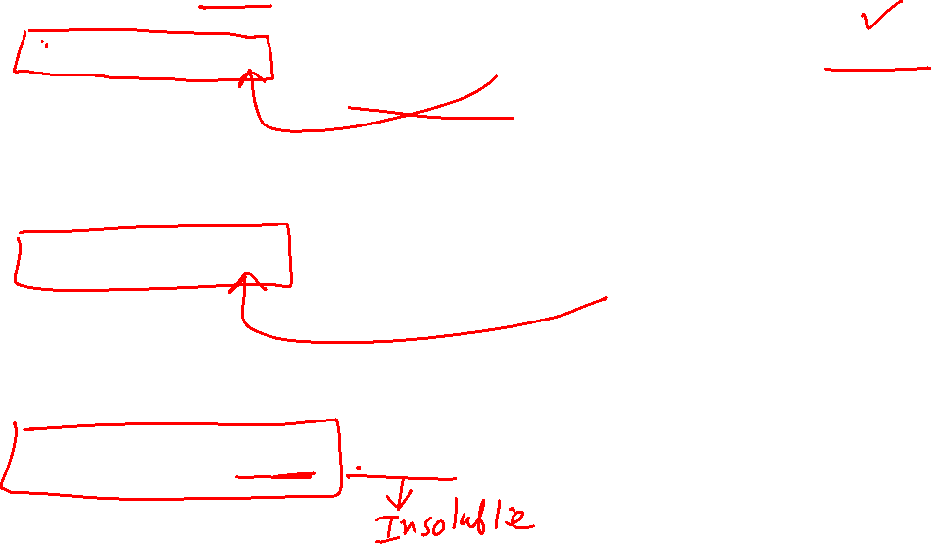

Slide 60

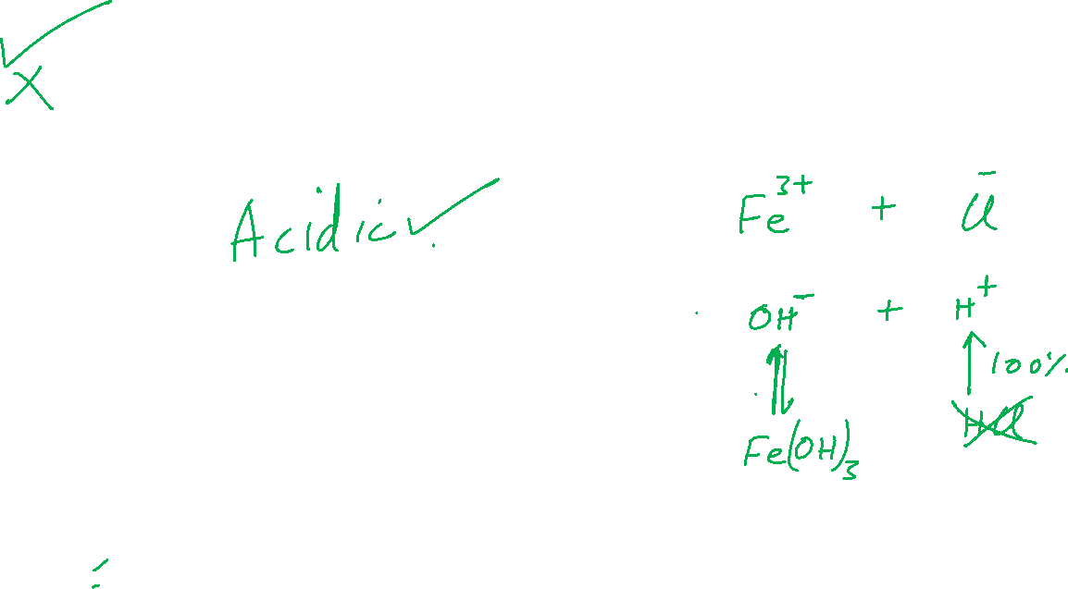

Slide 61
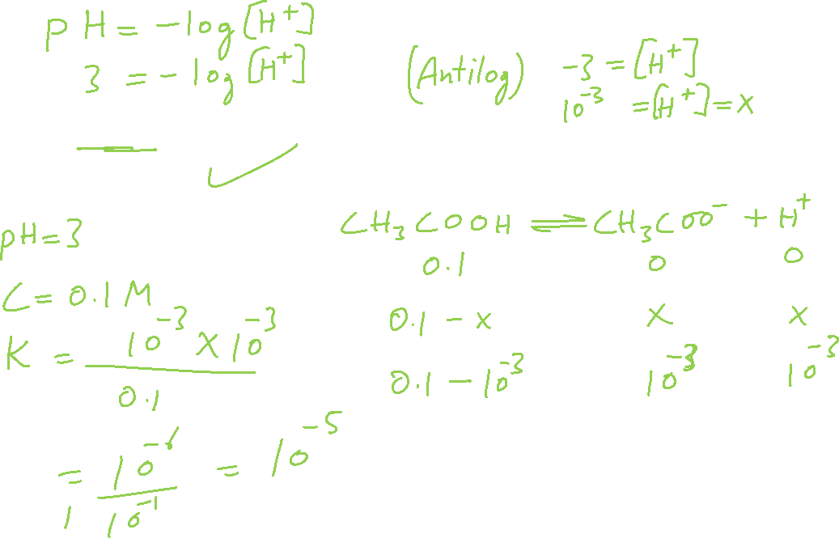

Slide 62
